Slide 1

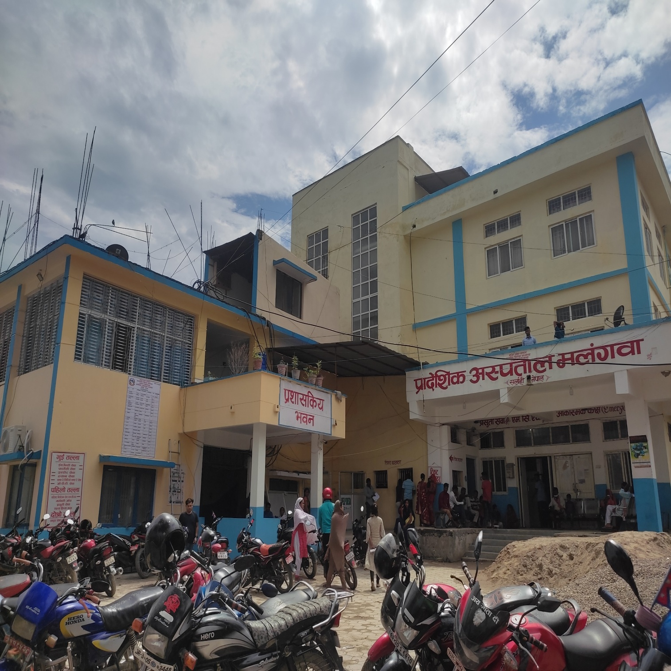
Provincial Hospital Malangwa
Annual Report FY 2078/79

Slide 2

Operating Budget for FY 2078/79
Budget | Budget Allocated | Budget Released | Budget Expenditure | Irregularities (BERUJU)
 |  |  |  | Amount | Clearances | % Clearances
Capital | Rs. 2,23,00,000 | Rs. 1,93,42,399 | Rs. 1,93,42,399 | 0 | 0 | 0
Recurrent | Rs. 12,56,60,000 | Rs. 11,18,95,807.62 | Rs. 11,18,95,807.62 | Rs. 50,000 | 0 | 0
Total | Rs. 14,79,60,000 | Rs. 13,12,38,206.62 | Rs. 13,12,38,206.62 | Rs. 50,000 | 0 | 0
% of Financial achievement: 89
% of Physical achievement: 100
Any comments: Construction of building need more budget.

Slide 3
Hospital Development Committee
Description
1. Financial Information | Amount (NPR)
2.1. Balance @ end Asaar 2078 | 2,23,00,000
2.2. Income (service fees, rent, donation etc.) | 2,54,40,648.41
2.3. Expenses | 2,31,24,936.20
2.4. Balance @ end Asaar 2077 | 20,86,413.84
2.5. Details of any donation received, gift in kind | 6,00,000 for Salary
2. . Number of meetings held in FY 2078/79 | 7

Slide 4
Human Resources
POSTS | GOVERNMENT |  | Development committee |  | CURRENTLY AVAILABLE
 | Sanctioned post | Fulfilled | Sanctioned post | Fulfilled | Among government sanction (in number) | Among development committee sanction (in number | Local and other resources
 | (in number) | (in number) | (in number) | (in number) |  |  | (in number)
Specialized Doctor -9th-11th | 9 | 1 | 1 | 1 | 1 | 1 | 2
Medical Officer -8th | 4 | 3 | 1 | 1 | 0 | 1 | 8
Nursing Officer 7th to 11th | 1 | 0 | 0 | 0 | 0 | 0 | 0
HA/Sr AHW | 5 | 2 | 6 | 6 | 1 | 6 | 1
Staff Nurse | 6 | 2 | 0 | 0 | 2 | 0 | 9
Radiographer/Dark room Assistant | 1 | 1 | 0 | 0 | 1 | 0 | 2
Lab tech./Assist. | 5 | 5 | 1 | 1 | 5 | 1 | 1
AHW | 0 | 0 | 6 | 6 | 0 | 6 | 0
ANM | 5 | 2 | 0 | 0 | 2 | 0 | 1
Administrative Staffs | 4 | 3 | 0 | 0 | 3 | 0 | 0
Medical Recorder | 1 | 0 | 0 | 0 | 0 | 0 | 0
Others | 18 | 6 | 17 | 17 | 4 | 17 | 0
Total | 59 | 25 | 32 | 32 | 19 | 32 | 22

Slide 5
MSS score Trend
Notes:
Show progress on MSS over time in the chart. To change the data, right click on chart, select Edit Data and enter the data for the respective hospital.

Slide 6
Comparison between last two Follow-Up Score
Name/Section | Number of Std. | Max Score | Follow-up 8 MSS Percentage | Follow-up 9 MSS Percentage | Follow-up 10 MSS Percentage | MSS Score
Governance and Management | 105 | 109 | 30% | 72 % | 83% | 90
Clinical Management | 478 | 682 | 46% | 46 % | 51% | 346
Hospital Support Service | 138 | 148 | 39% | 41% | 51% | 75
Total | 721 | 939 | 41% | 50% | 57% | 511

Slide 7
MSS Score Trend
Notes:
Show progress on MSS over time in the chart. To change the data, right click on chart, select Edit Data and enter the data for the respective hospital.

Slide 8
Key Performance Service Indicator ( Secondary-A)
SN | Key Service | Standards | Yes | No | Rational
1 | OPD Services | Different OPDs (Medical, Ob Gynec, Ortho, Pediatirc) | Yes
2 | IPD services | Separate Medical wards with assigned staffs | Yes
 |  | Separate Surgical wards with assigned staffs |  | N0 | Lack of space and HR
 |  | Separate Maternity ward with trained staffs | Yes
 |  | Separate paediatric ward with assigned staffs | Yes
3 | ER services | Separate ER Deparment with 24 hour service | Yes
 |  | Disaster Management Plan |  | No | On going.
 |  | Triage: Regular and disaster managementTriage | Yes
 |  | Equipment's: Defibrillator/ DC shock/ Patient monitor | Yes
 |  | HR- Trained HR 24 hour coverage/ ER incharge- MO/ MDGP | Yes
 |  | Emegency Procedure room in ER | Yes
 |  | Emergency Plan /Protocol in place | Yes
4 | Surgical services | Separate OT for regular and emergency surgery | Yes
 |  | HR: MDGP/ Ob Gyn/Surgen/ Ortho | Yes
 |  | Separate assigned Post operative ward | Yes
 |  | Types of procedurs : CS/Laparotomy/ general Surgery/ ortho/ all emergency life saving surgery | Yes |  | Only CS/Laparotomy services formed.
5 | Anesthesia | HR- AA/ Anesthesiologist | Yes |  | Only AA available.
 |  | GA mechine | Yes
Notes:
Use this slide to mention status of hospital services beyond the general services like ER, OPD, inpatient, delivery, Lab, X-ray etc.
Hospital pharmacy: please mention whether pharmacy is operating 24 hours or not and what kind of HR is working in pharmacy
Laboratory: the main interest is in culture and other tests beyond the range of MSS. Mention if hospital is able to provide thyroid tests etc.
Blood Bank: please mention status of blood bank
X-ray: mention whether the X-ray service is provided by digital technology and mention the HR providing service
Dental: what kinds of dental service are available and what level of HR is providing?
Extended Hospital Service (EHS): is the hospital providing EHS and if so, what kind of service?
Mention any other innovation by hospital

Slide 9
Key Performance Service Indicator ( Secondary-A)
SN | Key Service | Standards | Yes | No | Rational
6 | OPD Pharmacy | HR- # Pharmesist / other HR | Yes
 |  | 24 Hours service | Yes
 |  | OPD Hours + on call | Yes
7 | Laboratory | 24 hour services | Yes
 |  | Hematology | Yes
 |  | HR- Technologist/Technician/ Assistant | Yes
 |  | Biochemestry ( Sugar/ LFT/RFT/lipid profile) | Yes
 |  | Microbiology with Culture |  | No | On going.
 |  | T3, T4, TSH, | Yes
 |  | Equipment ( Auto/ Semi Auto Analyzer) | Yes
8 | Blood bank | Storage | Yes
 |  | Walking Blood Bank | Yes |  | With help of RC.
9 | X-ray service | HR-Rediologist/ Rediographer/ Darkroom assistant/ other | Yes
 |  | Functioning (300 MA or above) |  | No | On the process of installment.
 |  | Digital/ CR X-ray | Yes
 |  | Portable X-ray available and functioning | Yes
 | USG service | Available and well functioning | Yes
 |  | HR-Rediologist/ MDGP/MO |  | No | Only MDGP available
Please mention the status of the following services
Notes:
Use this slide to mention status of hospital services beyond the general services like ER, OPD, inpatient, delivery, Lab, X-ray etc.
Hospital pharmacy: please mention whether pharmacy is operating 24 hours or not and what kind of HR is working in pharmacy
Laboratory: the main interest is in culture and other tests beyond the range of MSS. Mention if hospital is able to provide thyroid tests etc.
Blood Bank: please mention status of blood bank
X-ray: mention whether the X-ray service is provided by digital technology and mention the HR providing service
Dental: what kinds of dental service are available and what level of HR is providing?
Extended Hospital Service (EHS): is the hospital providing EHS and if so, what kind of service?
Mention any other innovation by hospital

Slide 10
Key Performance Service Indicator ( Secondary-A)
SN | Key Service | Standards | Yes | No | Rational
10 | USG service | Available and well functioning | Yes
 |  | HR-Radiologist/ MDGP/MO |  | No
 | CT/MRI | Availability of CT/ MRI and functioning |  | No | Not available.
11 | Dental Services | Separate Dental Department | Yes
 |  | HR- Dental doctor/ hygienist | Yes
12 | CSSD Services | Separate CSSD department with assigned HR, enough equipment and supply as per hospital need | Yes
13 | Laundary Services | Separate Laundry department with assigned HR with enough supplies | Yes
14 | Security | 24 hour coverage (Either Police or security Guard) | Yes
15 | EHS | Expanded hospital service available after regular hour |  | No
16 | Electricity backup | Enough to run huspital regular services Lab and X-ray, OT services | Yes
Notes:
Use this slide to mention status of hospital services beyond the general services like ER, OPD, inpatient, delivery, Lab, X-ray etc.
Hospital pharmacy: please mention whether pharmacy is operating 24 hours or not and what kind of HR is working in pharmacy
Laboratory: the main interest is in culture and other tests beyond the range of MSS. Mention if hospital is able to provide thyroid tests etc.
Blood Bank: please mention status of blood bank
X-ray: mention whether the X-ray service is provided by digital technology and mention the HR providing service
Dental: what kinds of dental service are available and what level of HR is providing?
Extended Hospital Service (EHS): is the hospital providing EHS and if so, what kind of service?
Mention any other innovation by hospital

Slide 11
Key Performance Service Indicator ( Secondary-A)
SN | Key Service | Standards | Yes | No | Rational
17 | Health Care waste management | Separate area for waste management | Yes
 |  | Autoclaving of contaminated waste |  | No | On going.
 |  | Waste management plant | Yes
18 | E billing system | Central belling system | Yes
 |  | E billing separatly | Yes
19 | Electronic Health Record (EHR) | Available and well functioning in all departments of the hospital |  | No
20 | Oxyzen Supply | Central supply of O2 by Oxyzen plant | Yes
 |  | O2 contiontrator | Yes
 |  | O2 Cylinder | Yes
21 | Special Care Units | Separate HDU | Yes
 |  | Separate ICU/ SNCU, CCU |  | No | Only 2 beded SNCU functional .
22 | Special clinics | ATT/ART | Yes
 |  | Family planning | Yes
 |  | Safe Abortion | Yes
23 | Any other Services | OCMC or Separate area for Medico legal services, NRC..etc | Yes
 |  | Dialysis | Yes |  | Non- functioning due to staff and space.
 |  | Physiotherapy | Yes
Notes:
Use this slide to mention status of hospital services beyond the general services like ER, OPD, inpatient, delivery, Lab, X-ray etc.
Hospital pharmacy: please mention whether pharmacy is operating 24 hours or not and what kind of HR is working in pharmacy
Laboratory: the main interest is in culture and other tests beyond the range of MSS. Mention if hospital is able to provide thyroid tests etc.
Blood Bank: please mention status of blood bank
X-ray: mention whether the X-ray service is provided by digital technology and mention the HR providing service
Dental: what kinds of dental service are available and what level of HR is providing?
Extended Hospital Service (EHS): is the hospital providing EHS and if so, what kind of service?
Mention any other innovation by hospital

Slide 12
Hospital Beds
Description | Total
Sanctioned Beds (Government) | 50
Sanctioned Beds (Development committee)
Total operational Beds | 80
Emergency beds | 11
Total Inpatient beds | 15
Maternity beds | 32
ICU beds | 0
NICU beds | 0
Geriatric beds | 3
SNCU beds | 2
Other | 17 (Covid)

Slide 13
COVID-19: Preparedness and Response
Number of Isolation bed: 17
Number of ICU bed: 10 (Not Functional)
Number of PICU: 5 (Not Functional)
Total number of Ventilators: 4 (Not Functional)
Number of HDU: 15
Number of O2 cylinder: 150
Number of O2 concentrator: 45

Slide 14
COVID-19: Preparedness and Response
Service Availability | Installation / not Inst. | Production capacity/day | If not, Mention the reason | Remarks
O2 plant | Installed | 19 cylinder
Autoclave | Process of Installation
EMR | Non-Installed
O2 pipeline | Installed
O2 supply manifold system | Non-Installed

Slide 15
Existing Hospital Building and land
Hospital owned land: 18 Katha
Building:
विवरण | संख्या | अपर्याप्त भए कति र कुन प्रयोजन को लागि
Hospital Room | 45 | 30 अपर्याप्त
Doctor quarter: | 0 | 15 अपर्याप्त
Nurses quarter: | 0 | 15 अपर्याप्त
Paramedics quarter: | 0 | 15 अपर्याप्त
Other Staff quarter: | 0 | 20 अपर्याप्त

Slide 16
Ambulance Services
Total number | Type of Ambulance
4 | ग
Functional | Non Functional
3 | 1

Slide 17
Status of Major Medical Equipments
Department | Name of equipments | Quantities
 |  | Functional | Non Functional
Operation Theater | 1. Patient Monitor 2. 24 cautery Machine 3. Anesthesia workstation | Functional
Laboratory | 1. Hematology Analyzer 2. CLIA Machine 3. Nephrometry Machine | Functional
Radiology: | 1. USG Machine 2. CR X-ray 3. Mobile X-ray | Functional

Slide 18
Status of Major Medical Equipments
Department | Name of equipments | Quantities
 |  | Functional | Non Functional
Emergency | 1. Patient Monitor 2. O2 Concentrator 3. ECG Machine | Functional
ICU | 1. ICU Bed 2. O2 Concentrator 3. Ventilator |  | Non-Functional
NICU | 1. Radiant Warmer 2. Photo Therapy 3. Mobile X-ray |  | Non-Functional

Slide 19
Medical Waste Management in Hospital
S. No. | Activities | Current Practice | Number of Equipment | Condition of equipment
1 | Segregation of risk and non-risk waste | Yes | 1 | Good
2 | Autoclaving for risk waste | On process | 1 | Good
3 | Use of Needle Cutter/ Needle Destroyer | Yes | 1 | Good
4 | Use of placenta Pit | Yes | 1 | Good
Note: Please mention current practice of final waste disposal system in Hospital (e.g. open burning, dispose in municipality/ Private container etc.) Open burnning.

Slide 20
Status of the major indicators
Indicators | 2076/77 | 2077/78 | 2078/79
% of Monthly Report Entered | 50 | 70 | 95
% of Monthly Report Entered within time | 20 | 70 | 95
Total number of OPDs | 8250 | 91150 | 13116
Total number of Inpatients | 1500 | 1744 | 3251
Total number of Emergency | 12163 | 17340 | 18038
Total number of Delivery | 1501 | 1744 | 1927
Total number of CS/major | 63 | 65 | 151
Total number of Major surgeries | 0 | 40 | 50
Average length of stay |  |  | 3.4

Slide 21
Status of the major indicators
Indicators | 2076/77 | 2077/78 | 2078/79
% of Surgeries among In-Patients |  | 2.82 | 3.77
Infection rate among surgical cases | 2 | 3 | 3.5
Surgery related Death rate | 0 | 0 | 0
Outpatient Sex Ratio | 0 | 90 | 82
Inpatient sex Ratio | 0 | 0 | 8
Deaths within 48 hours of Admission | 13 | 11 | 7
Deaths after 48 hours of Admission | 8 | 5 | 3
Average number of radiographic images per day | 28 | 30 | 35
Average number of laboratory tests per day | 240 | 250 | 300

Slide 22
Safe Abortion
Indicator | 2076/77 | 2077/78 | 2078/79
1. No of CAC (Surgical Abortion) | 0 | 0 | 0
2. No of CAC (Medical Abortion) | 68 | 349 | 485
3. Proportion of <20 yrs women receiving abortion service | 0 | 0 | 0
4. No of abortion complication | 5 | 7 | 10
5. Proportion of Long-term contraception among post abortion contraception used | 60 | 124 | 240
6. No of PAC | 76 | 62 | 54

Slide 23
Major Achievements during FY 2078/79
1. Fulfillment of 3 specialist Dr. and and other staff on Contract.
2. Establishment of Bood Bank with the help of RC.
3. Establishment O2 plant and O2 Pipeline.
4. Extension of Laboratory services.
5. Procurement of ICU/PICU beds and equipment.
6. Establishment of Autoclave, washing machine, shredders (waste management System)
7. Completed of Compound wall.
8. Upgrading of Postmortem room.
9. Initiation of staff quarter.
10. Establishment of Indoor services/Jeriatric ward.
11. Beginning of SSU.
12. Establishment of Simulation room.
13. Ground paving
14. Upgrading emergency with monitor.

Slide 24
अस्पतालको फार्मेसी
२०७८/७९ जम्मा बिनियोजित बजेट रूः ०
बिषय -वस्तु | विवरण
फार्मेसी संचालन गरेको मिति | 2072
फार्मेसीमा उपलब्ध औषधिहरूको संख्या | 200
फार्मेसीमा कार्यरत जनशक्ती संख्या (जना) | 3
Software को अबस्था (उपलब्धता, अवस्था) | 0
बार्षिक आम्दानी रकम (रू) | 0
बार्षिक खर्च (औषधि खरिद, कर्मचारी तथा अन्य) रू. | 0
बार्षिक खुद आम्दानी रू. | 0

Slide 25
Top ten Morbidity
Rank | Causes of Morbidity 2078/79 | % Among Total OPD Visit | Rank in 2078/79
1 | URTI | 26.66 | 1
2 | APD | 22.85 | 2
3 | UTI | 15.35 | 3
4 | Disability checkup | 7.61 | 4
5 | LRTI | 6.86 | 5
6 | Dog animal bite | 6.45 | 7
7 | Hypertension | 4.95 | 8
8 | Diabetes | 1.52 | 9
9 | Enter Fever | 1.14 | 10
10 | Others | 6.69 | 6
Total OPD Cases: |  | 13,127
Issues: Few OPD room available.
Actions: Request to MOSD
Way Forward: Construction of new building.

Slide 26
Hospital Deaths FY 2078/79
Number of Maternal Death at Hospital : 1
Number of Neonatal Death at Hospital : 0
Number of Prenatal Deaths in hospital : 17
Number of still births : 17
Number of early neonatal deaths : 0
Number of hospital maternal deaths reviewed : 1
Number of hospital prenatal deaths reviewed : 12
Causes of Death, response and way forward:

Slide 27
Hospital Based One Stop Crisis Management Center (OCMC)
Type of Crime | Total number of cases (New)
 | 2076/77 | 2077/78 | 2078/79
Sexual Assault | 118 | 172 | 167
Physical Assault | 46 | 26 | 36
Domestic Violence | 4 | 1 | 12
Other | 6 | 0 | 10
Total | 118 | 172 | 167

Slide 28

Inpatients Admitted and Discharged in FY 2078/79
Admitted Number |  |  | Discharged Number
Female | Male | Total | Female | Male | Total
2149 | 187 | 2336 | 2149 | 187 | 2149
Issues: Not separate male, female and medical surgical ward due to insufficient.
Actions: Need to upgrading of infrastructure and HR.
Way Forward: Request local and provincial government.

Slide 29
Emergency care in FY 2078/79
Age Group | Number |  |  | %
 | Female | Male | Total | Female | Male | Total
Up to 14 Yrs | 1152 | 2337 | 3489 | 6.34 | 13 | 19.34
15 to 49 Yrs | 3238 | 4162 | 7400 | 18 | 23 | 41
50-59 Yrs | 2125 | 2162 | 4287 | 11.78 | 11.98 | 23.76
60+Yrs | 1037 | 1825 | 2862 | 5.74 | 10 | 15.74
Total | 7552 | 10486 | 18038 | 42 | 58 | 100
Issues: Lack of separate emergency infrastructure. No disaster contingency plan. Insufficient guideline protocol.
Actions: Construction of emergency block, preparation of contingency plan. Develop of protocol guideline.
Way Forward: Request to provincial government.

Slide 30
Total Patients Served by Social Service Unit
FY 2078/79
Target Group | Number |  |  | %
 | Female | Male | Total | Female | Male | Total
Ultra Poor and Poor | 0 | 0 | 0 | 0 | 0 | 0
Helpless | 7 | 3 | 10 | 70 | 30 | 100
Person with Disability | 0 | 2 | 2 | 0 | 100 | 100
Senior Citizen | 1 | 1 | 2 | 50 | 50 | 100
Victims of Gender Based Violence | 0 | 0 | 0 | 0 | 0 | 0
FCHV | 0 | 0 | 0 | 0 | 0 | 0
Total | 8 | 6 | 14 | 57.14 | 42.86 | 100
Issues:
Actions:
Way Forward:

Slide 31
Planed Action during last MSS Assessment and its status- Section One
Priority No | Planed Activities | Current Status (C= completed, O = Ongoing, N= Not done) | Remarks
1 | Separate space is available for patient's visitors (Kuruwa Ghar) | N
2 | Whole site coaching/ orientation on health care waste management is done | O
3 | Adequate space for practitioner and patient for USG with working table and examination bed one per each USG machine | C
4 | The hospital has a statement of patient rights and responsibilities, which is posted in public places in the hospital. | O
Plan 1
Plan 2
Plan 3
Plan 4
Plan 5

Slide 32
Planed Action during last MSS Assessment and its status- Section Two
Priority No | Planed Activities | Current Status (C= completed, O = Ongoing, N= Not done) | Remarks
5 | Morning conference is conducted everyday | O
6 | The hospital has assessed the hospital quality using the MSS tool at least every 4 months | O
7 | Telephone facility is available with list of important contact numbers and hospital codes visibly kept | N
Plan 1
Plan 2
Plan 3
Plan 4
Plan 5

Slide 33
Planed Action during last MSS Assessment and its status- Section Three
Priority No | Planed Activities | Current Status (C= completed, O = Ongoing, N= Not done) | Remarks
8 | Hospital maintains a triage system in the ER with 24 hours triage service | C
9 | Hospital carried out at least one mock preparedness once a year | O
10 | Management committee to manage 24 hours SSU services for patients | C
Plan 1
Plan 2
Plan 3
Plan 4
Plan 5

Slide 34
Prioritized Action Plan develop during last MSS assessment
Current Status | Total of action | % of action | Remarks
Total planed action | 10
Completed planed action ( C) | 3 | 30%
Ongoing planed action (O) | 5 | 50%
Not done planed action (N) | 2 | 20%

Slide 35
MAJOR STRENGTH
24 hours running CEONC service.
Functional O2 Plant.
Blood Bank in Hospital premises.
Extended Lab service.
Well manage OT.
Motivated and Dedicated main power.
Functional SSU, Geriatric and OCMC services.
Functional two ambulance and one mortuary van.
24 hours electric backup.

Slide 36
MAJOR WEAKNESS
Insufficient infrastructure. (Building, Land)
Insufficient Human resources.
ICU, PICU and Dialysis available but non-functional.
X-ray service not available during night.
Poor functioning pharmacy services.
Poor waste management.

Slide 37
MAJOR OPPORTUNITY
Well coordination with other government Institution and developement partner.
Referral chain managed.

Slide 38
FAILURE (MOTIVATING) STORY
Unable to run ICU and Dialysis service.
Unable to get specialized Doctor.

Slide 39
Major priorities for hospital strengthen
(Game changer )
24 CEONC services.
24 extended Lab Service.
Regularity of staff .

Slide 40
Proposed Activities for future
Prioritized Gap | Action Step to be taken to fulfill the gaps | Person Responsible | Time Frame | Tentative Cost | Type of Support (Managerial) | Type of Support (Budgetary)
Separate space is avaiable for patient's visitors (Kuruwa Ghar) | Repair and Maintainence | Hospital Administration | 6 months | NRS 500000 |  | HDC/Equalization Fund
immunization and growth monitoring clinic | Establishment | Hospital Administration and Distric health office | 4 months | Nominal |  | HDC
At least 2 KMC chairs available for providing KMC to premature and preterm babies | Establishment | Hospital Administration | 2 Months | NRS 300000 |  | HDC
Hospital carried out at least one mock preparedness once a year | Starting | Hospital Administration | 1 Month | NRS 15000 |  | HDC

Slide 41
Proposed Activities for future
Prioritized Gap | Action Step to be taken to fulfill the gaps | Person Responsible | Time Frame | Tentative Cost | Type of Support (Managerial) | Type of Support (Budgetary)
The hospital has mass casualty management protocol, and all staffs are updated with well labelled direction, prepositioning clipboards | Implementation | ER Incharge and MO | 1 Month | NRS 20000 |  | HDC
Hospital Canteen Management | Standardization | Hospital Administration | 6 Months | NRS 1000000 |  | HDC/Equalization Fund
Telephone facility is available with list of important contact numbers and hospital codes visibly kept | will be displayed | HDC + Logistics | 1 month | NRS 25000 |  | HDC fund
Medication trolley has well labeled buckets for segregation of waste during procedures | Implementation | Store and logistics | 2 Months | NRS 100000 |  | HDC fund
Hospital uses transportation trolleys separate for risk and non-risk waste | Implementation | Store and logistics | 2 Months | NRS 25000 |  | HDC fund

Slide 42
Proposed Activities for future
Prioritized Gap | Action Step to be taken to fulfill the gaps | Person Responsible | Time Frame | Tentative Cost | Type of Support (Managerial) | Type of Support (Budgetary)
Garden and trees should cover at least 25% of the hospital premises | Plantation Programme | All Hospital Staffs | 1 Month | NRS 15000 |  | HDC fund
Separate transformer for hospital
Tanning Hall upgrading up.
Upgrading up Kitchen and canteen
Manatainance of Kuruwa Ghar.
Construction of Hospital gate.
Completeness of staff quarter.

Slide 43
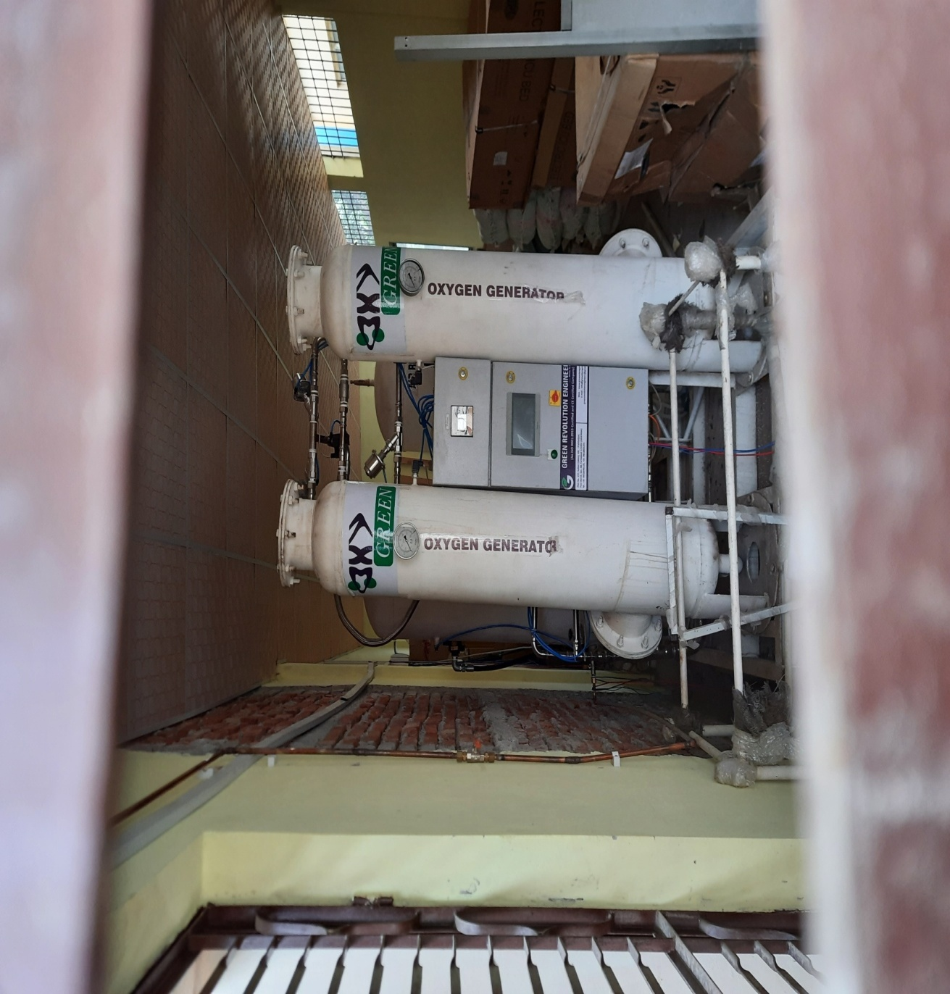
Oxygen Plant

Slide 44
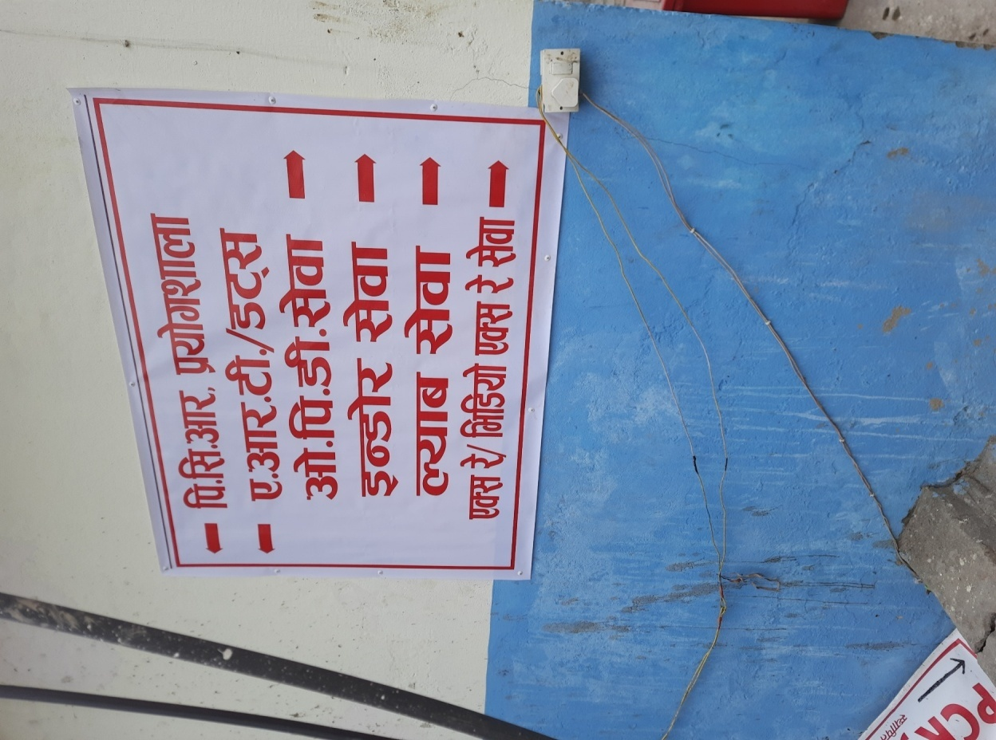
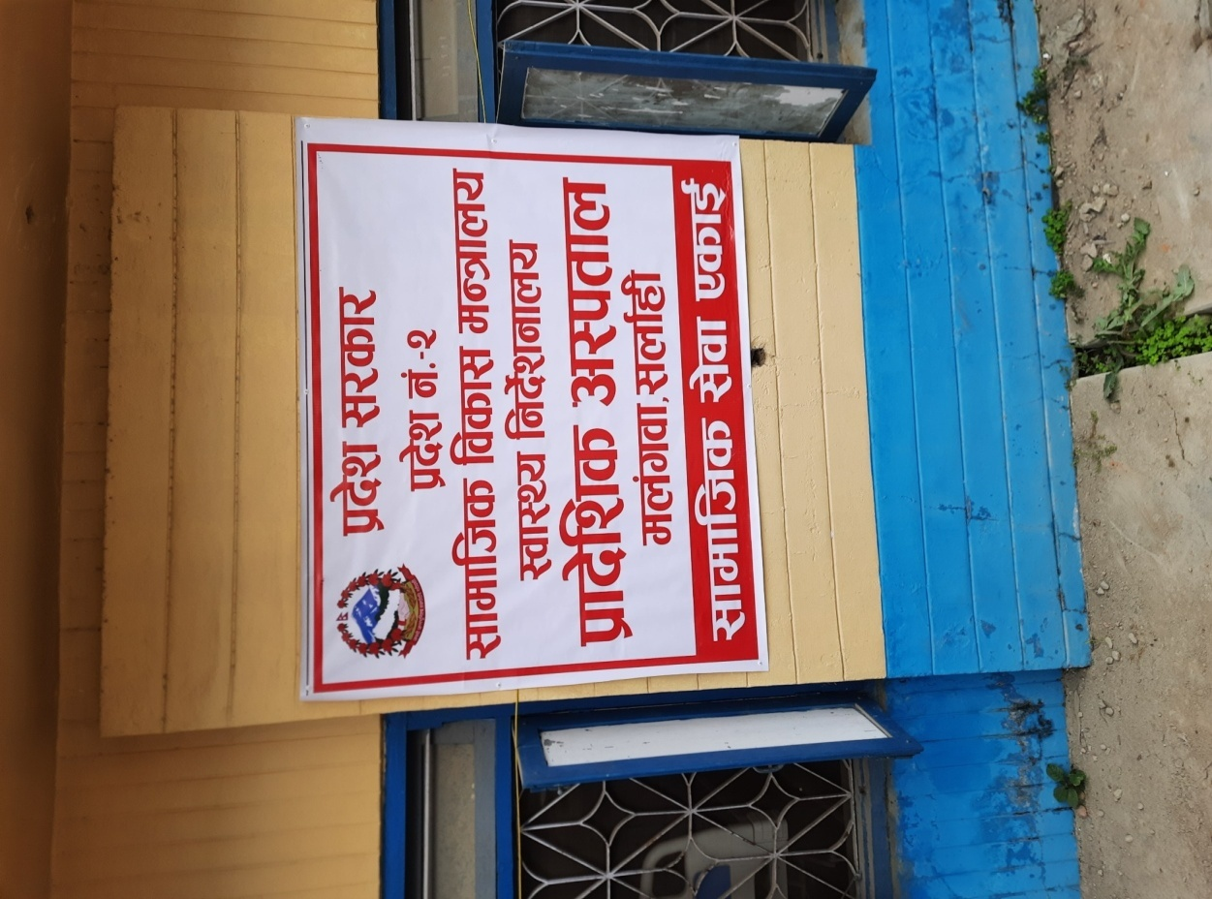
Hospital Photos to justify previous presentations

Slide 45
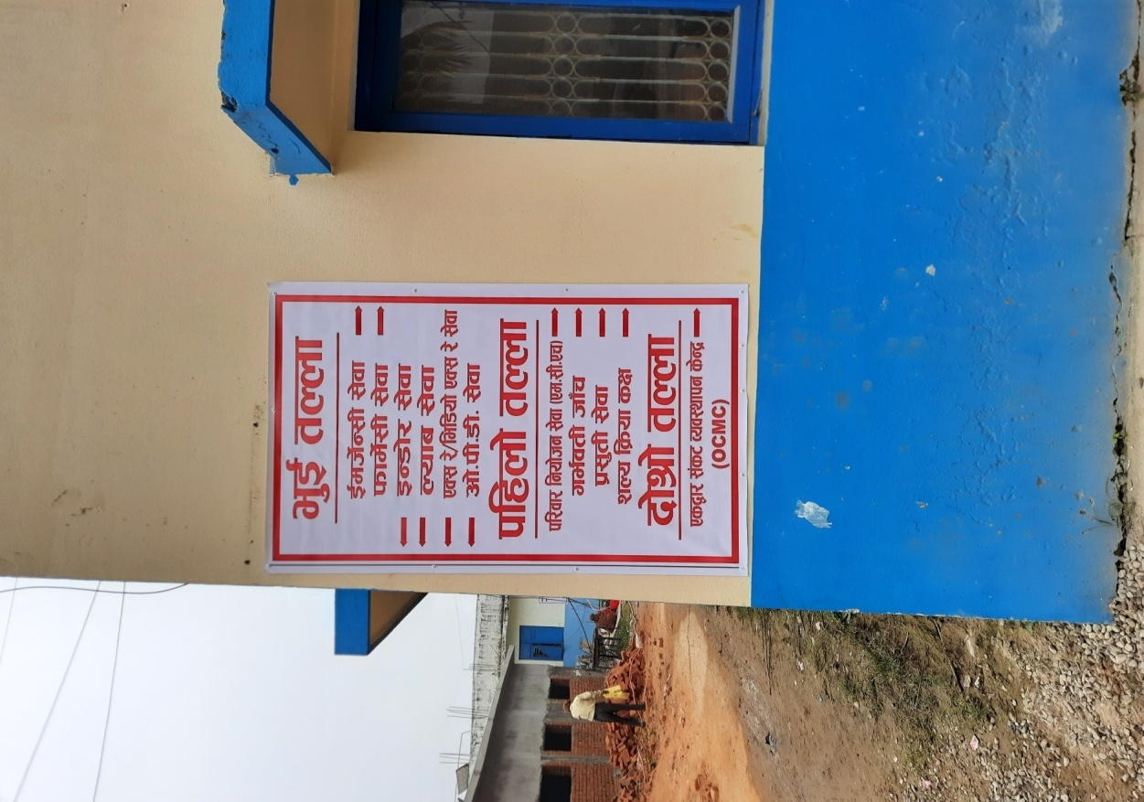
Hospital Photos to justify previous presentations
Notes:
Include any relevant photos to illustrate changes or improvements made by the hospital.

Slide 46
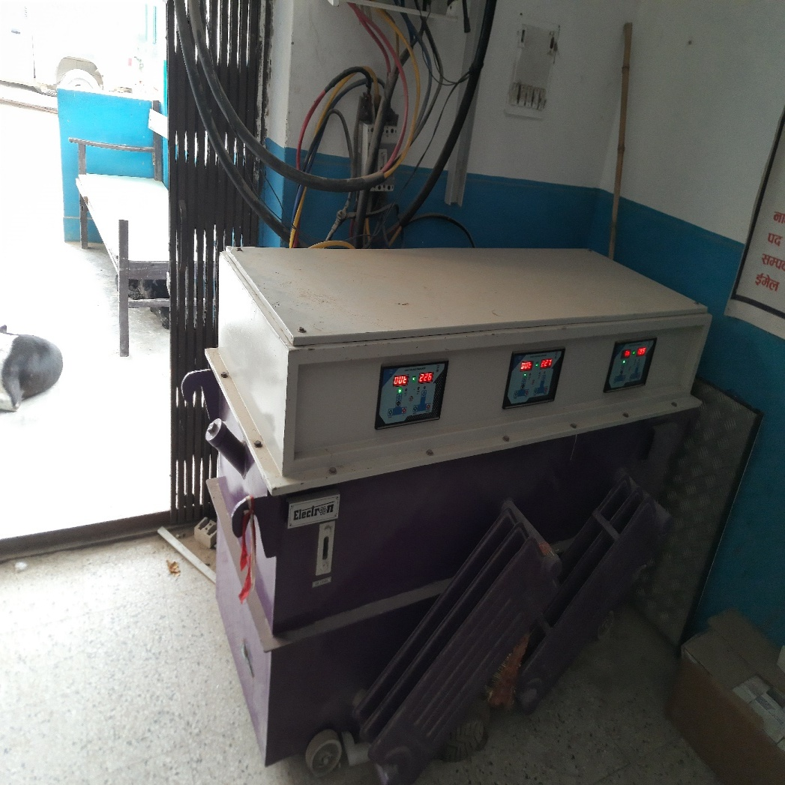
50 KV Stabilizer

Slide 47
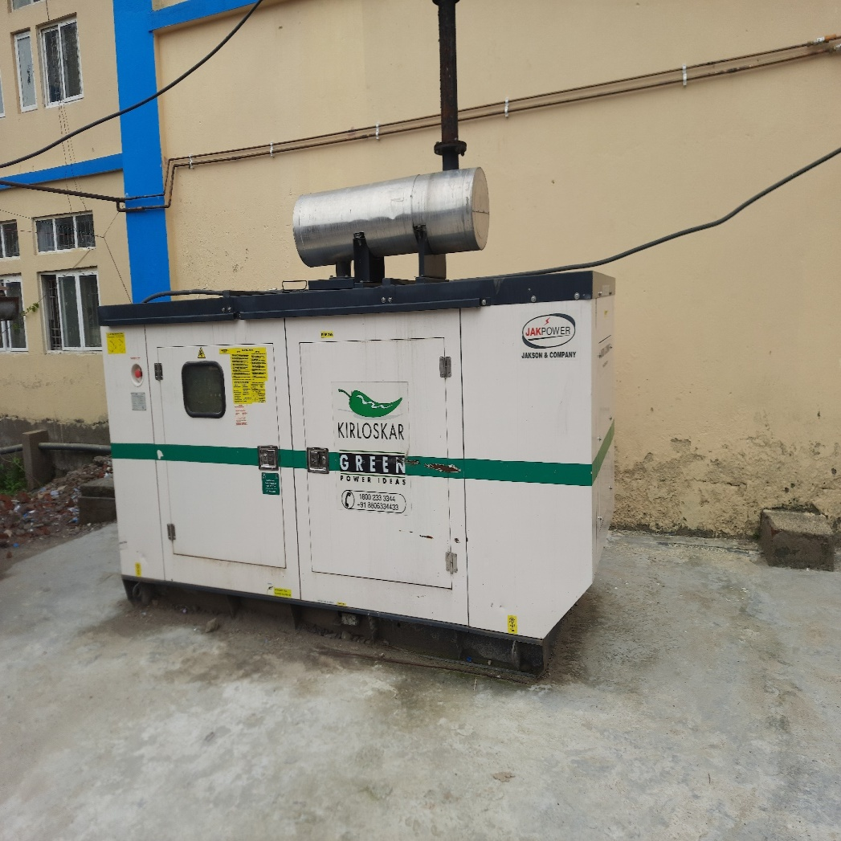
Power backup

Slide 48
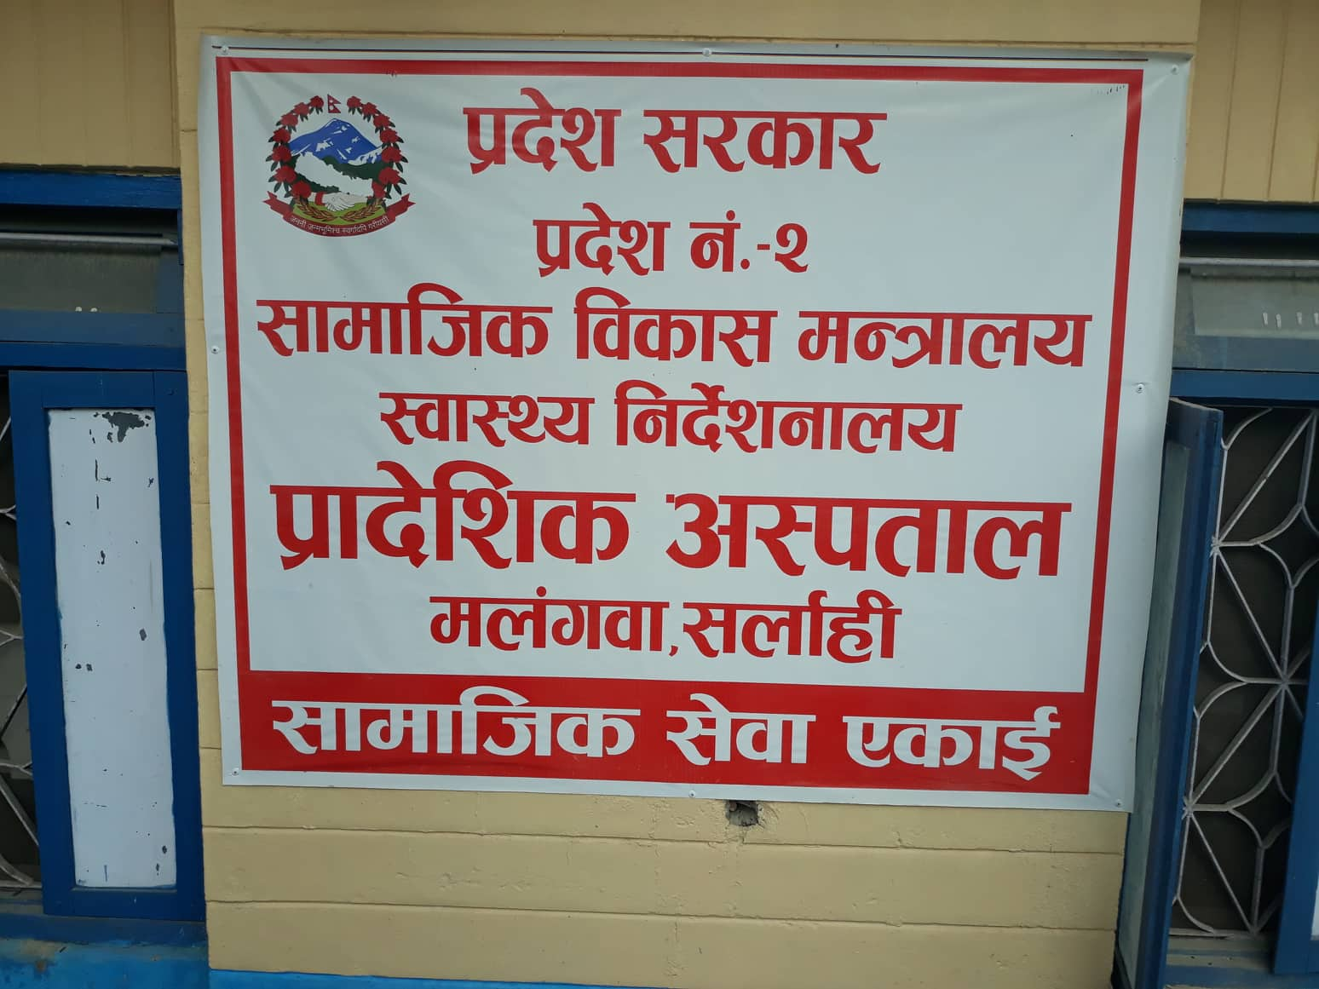
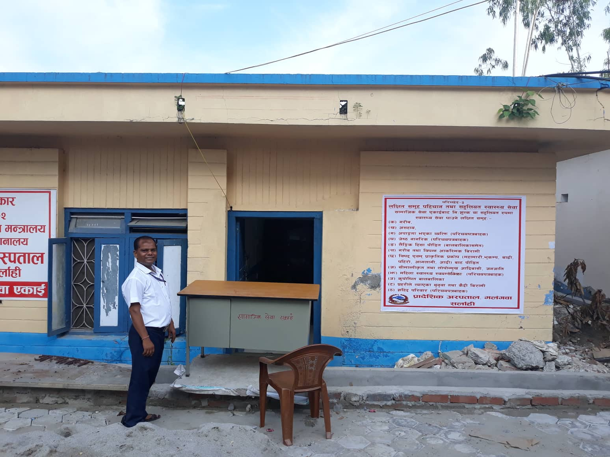
SOCIAL SERVICE UNIT
√
Notes:
Include any relevant photos to illustrate changes or improvements made by the hospital.

Slide 49
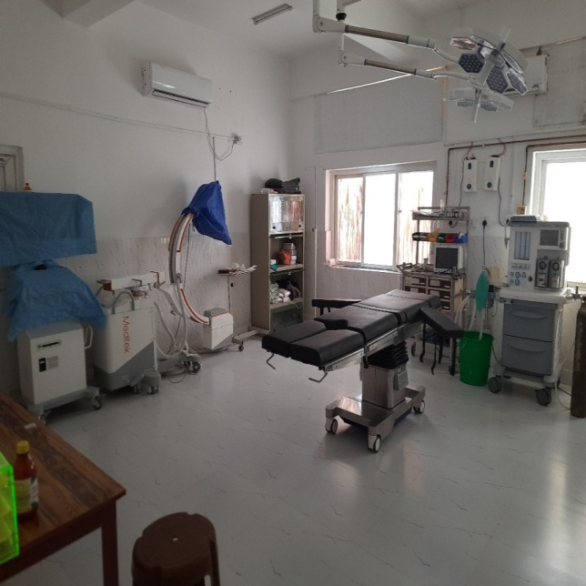
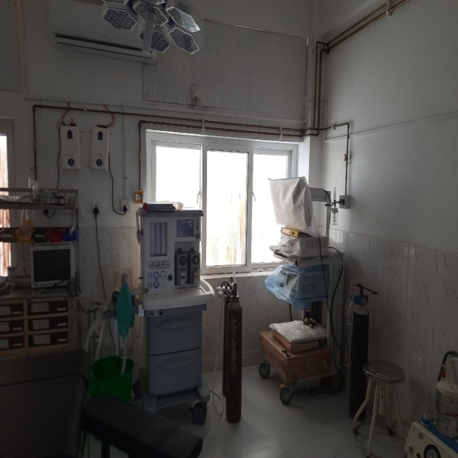
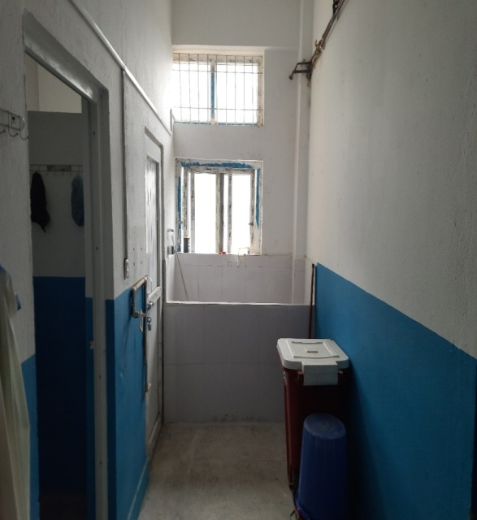
Operation Theatre

Slide 50
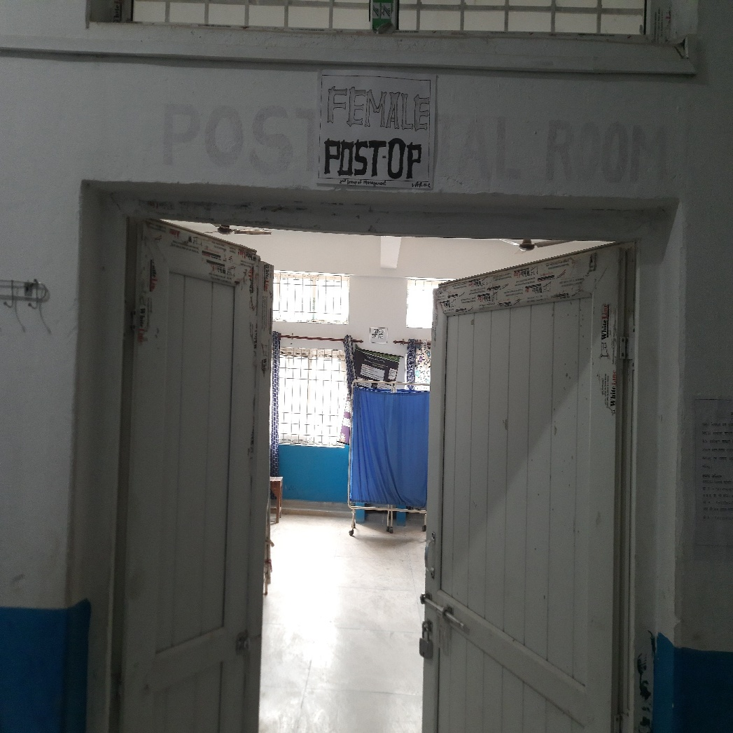
Post operative ward

Slide 51
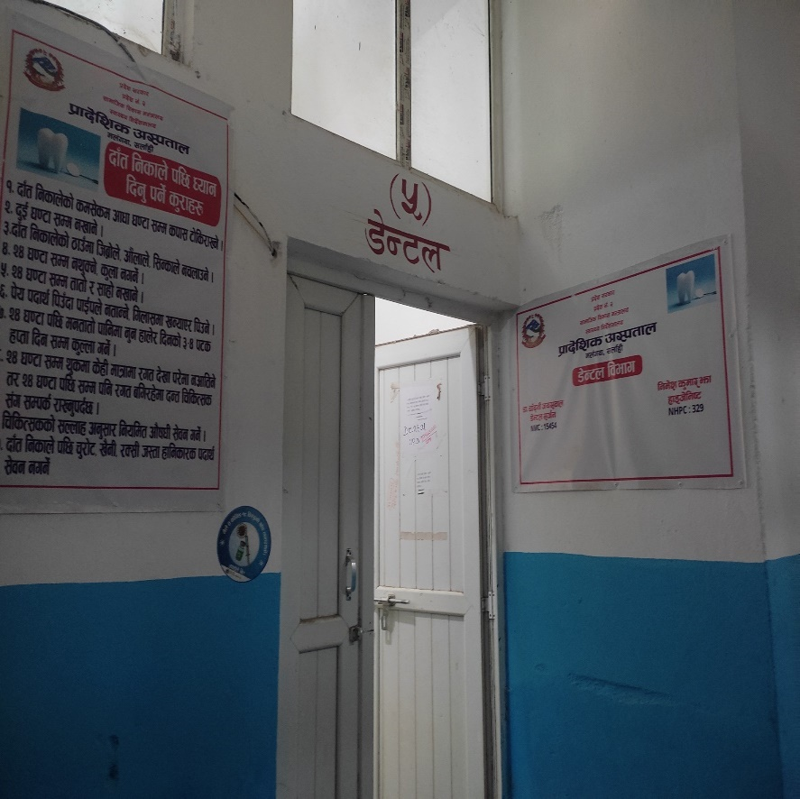
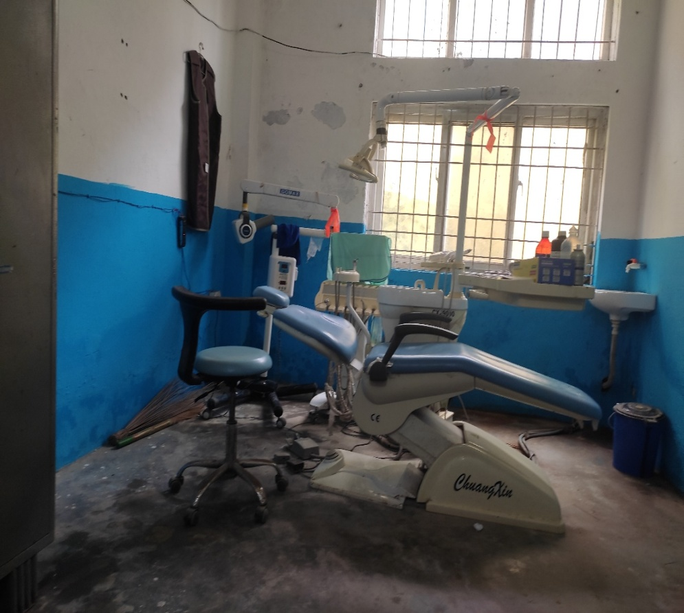
Dental room

Slide 52
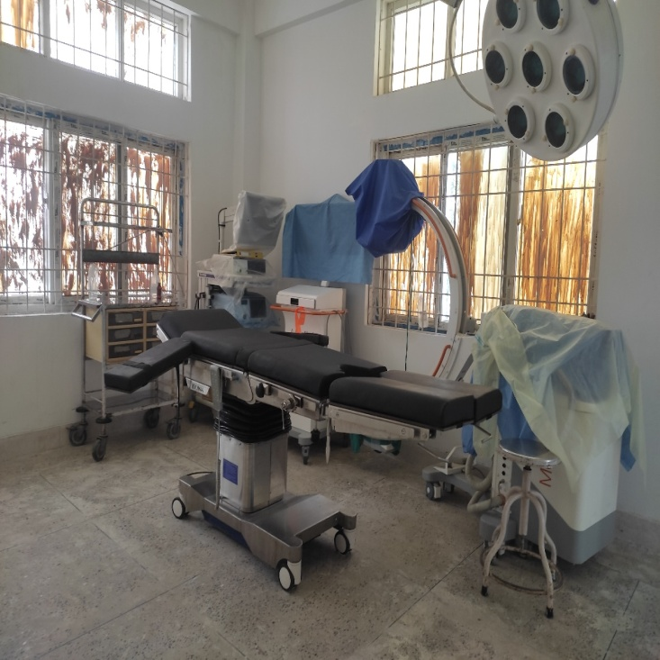
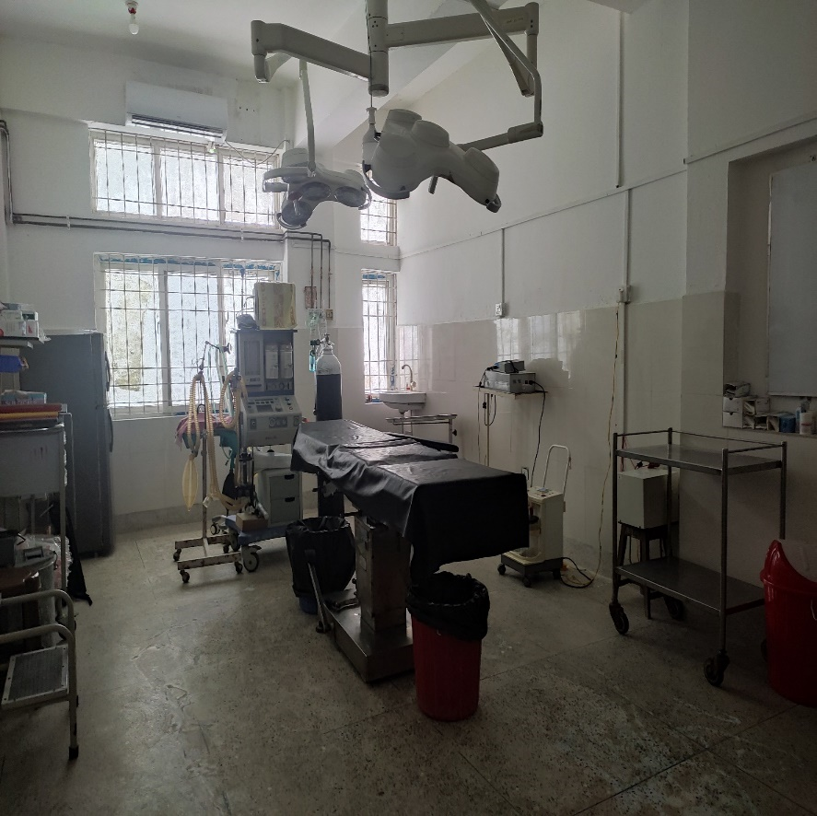
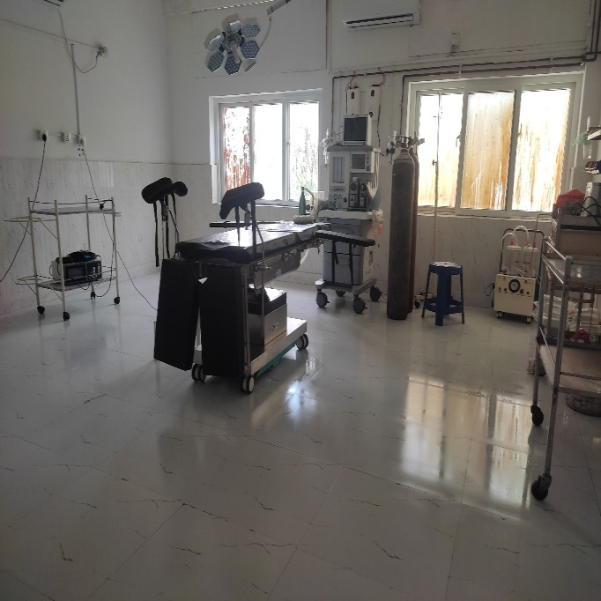
OT ROOM

Slide 53
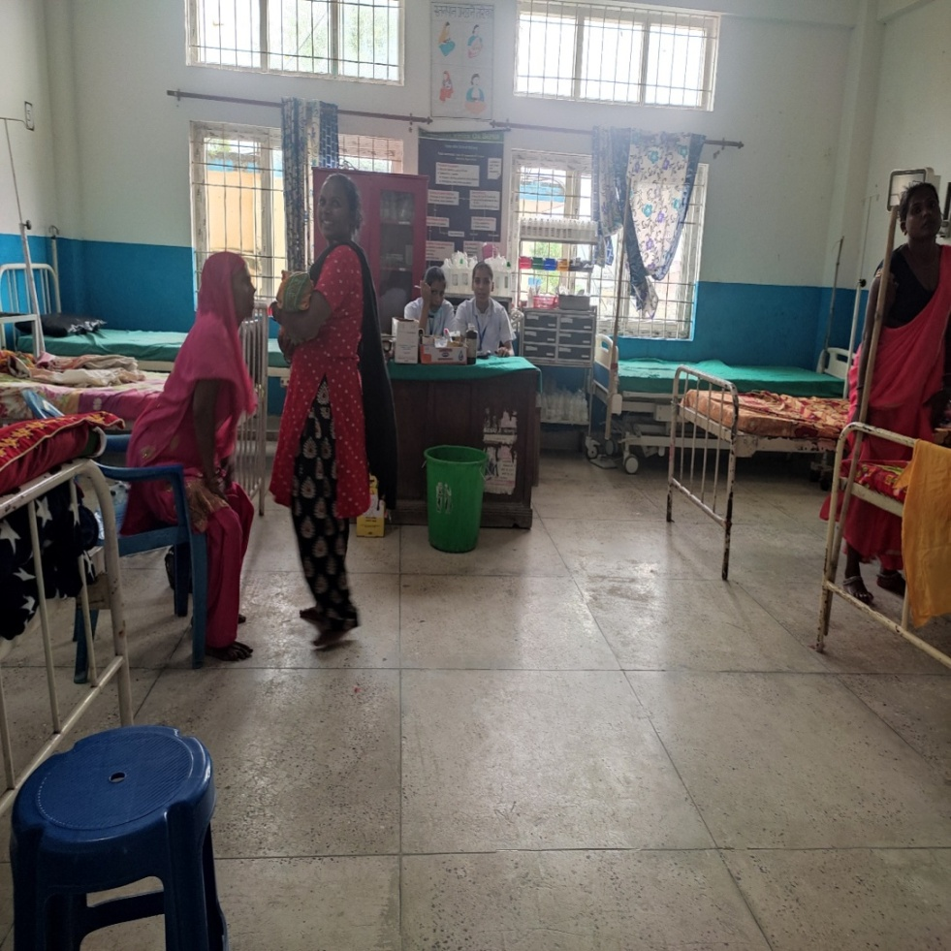
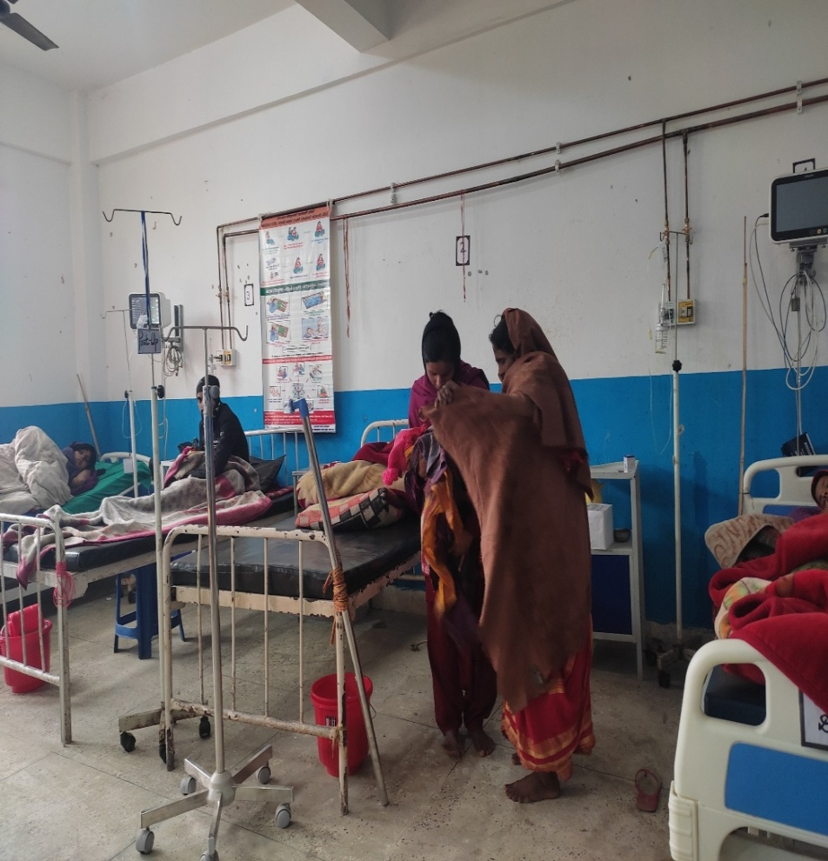
Post-Operative Room

Slide 54
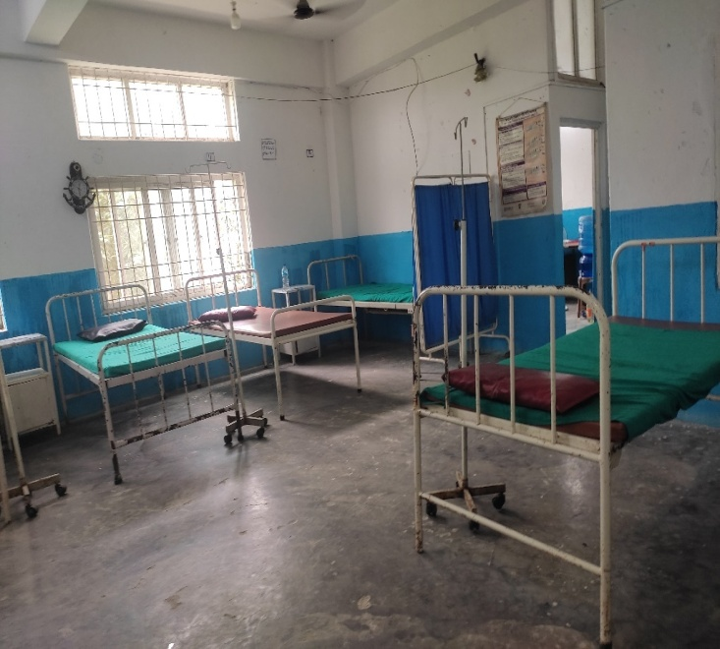
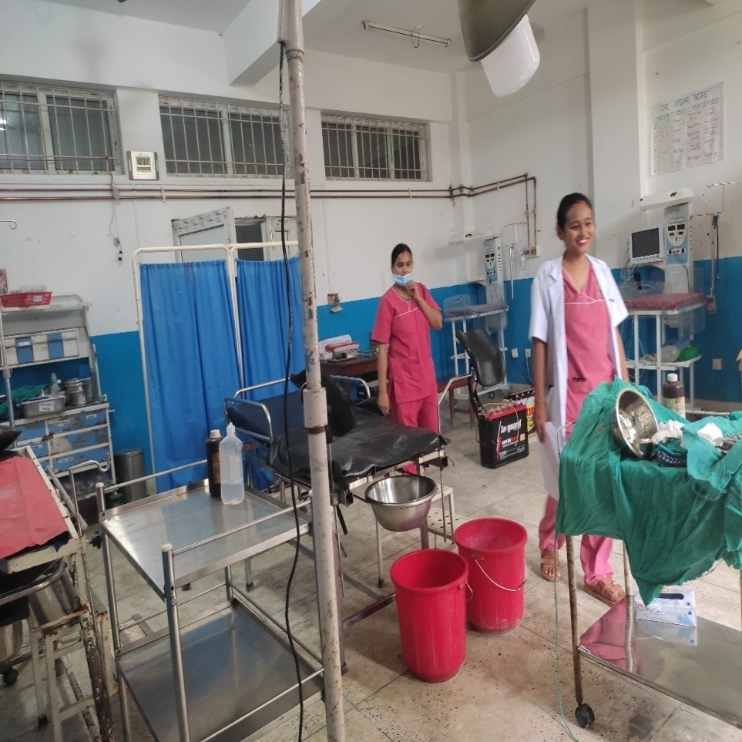
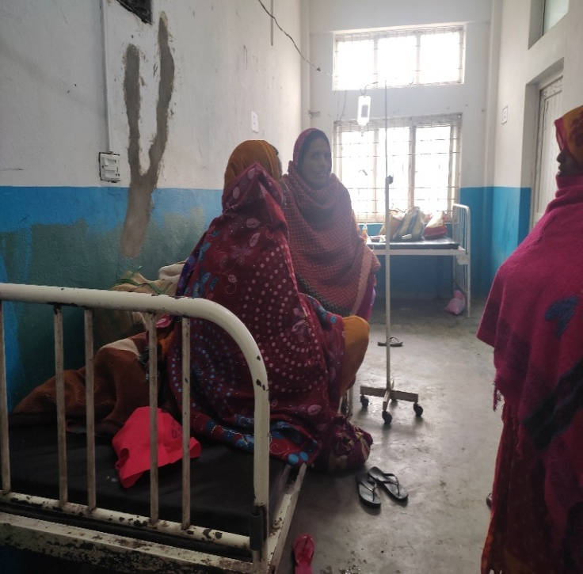
Delivery Room at Malangawa Hospital
Pre-labor Room
PNC Room

Slide 55
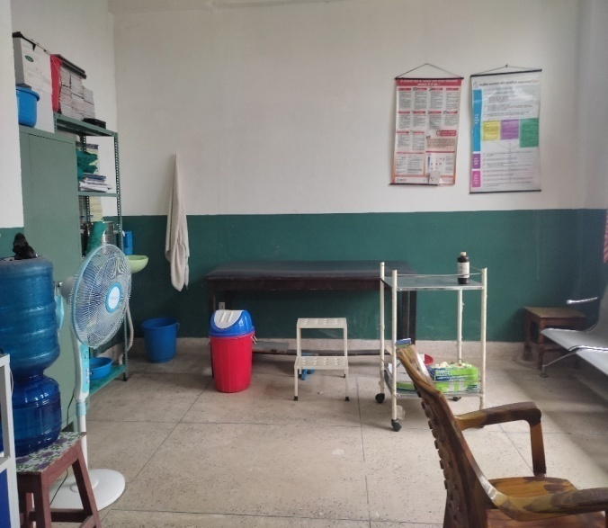
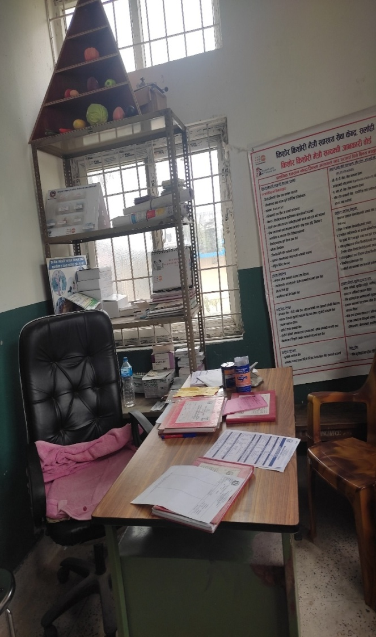
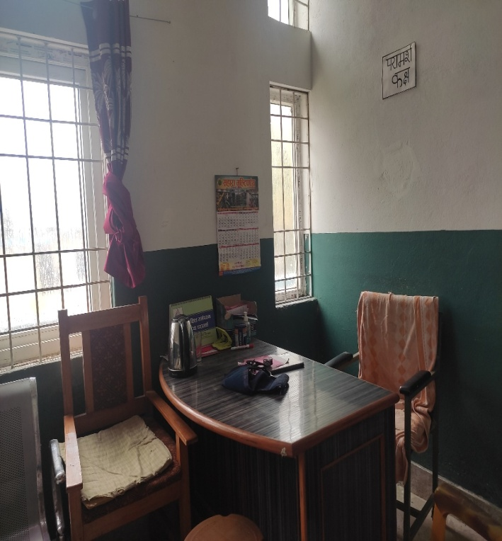
Family Planning and Safe Abortion Service

Slide 56
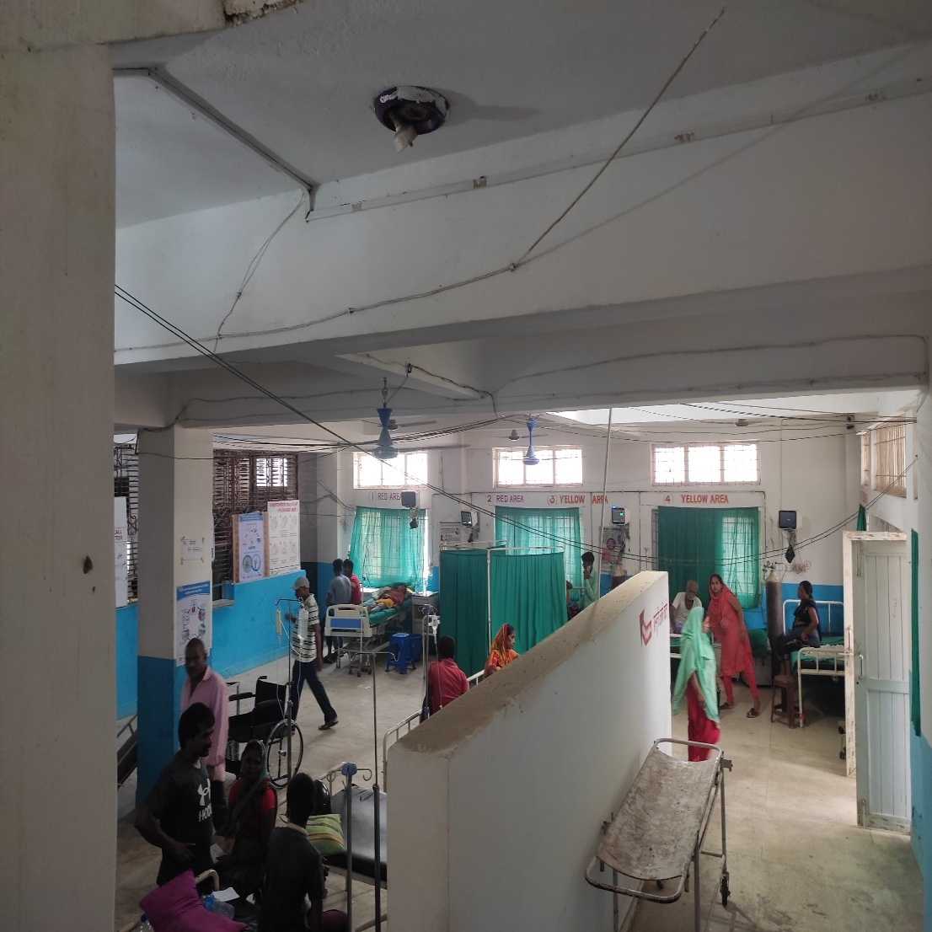
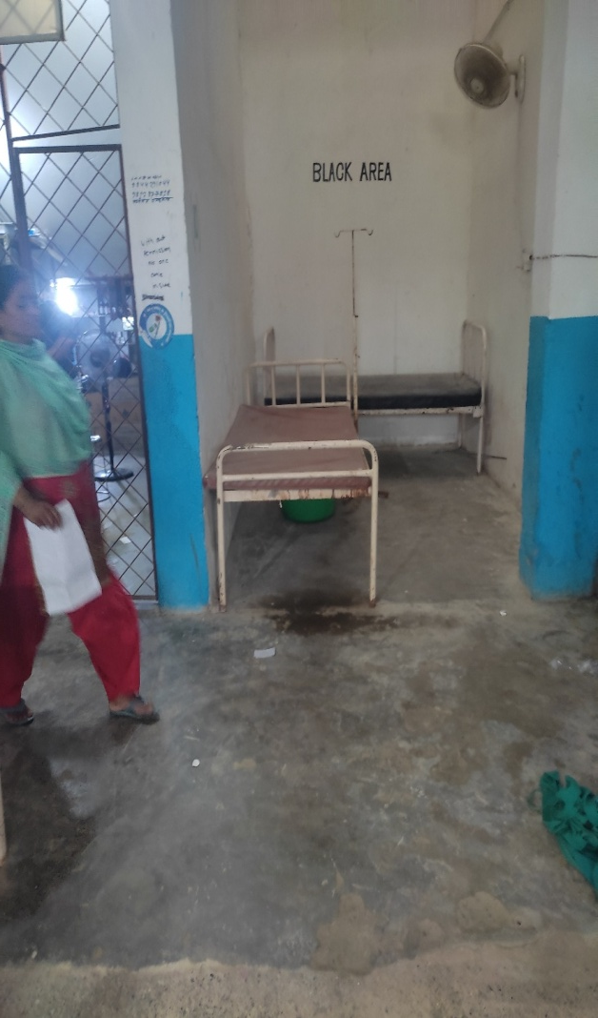
Emergency Room

Slide 57
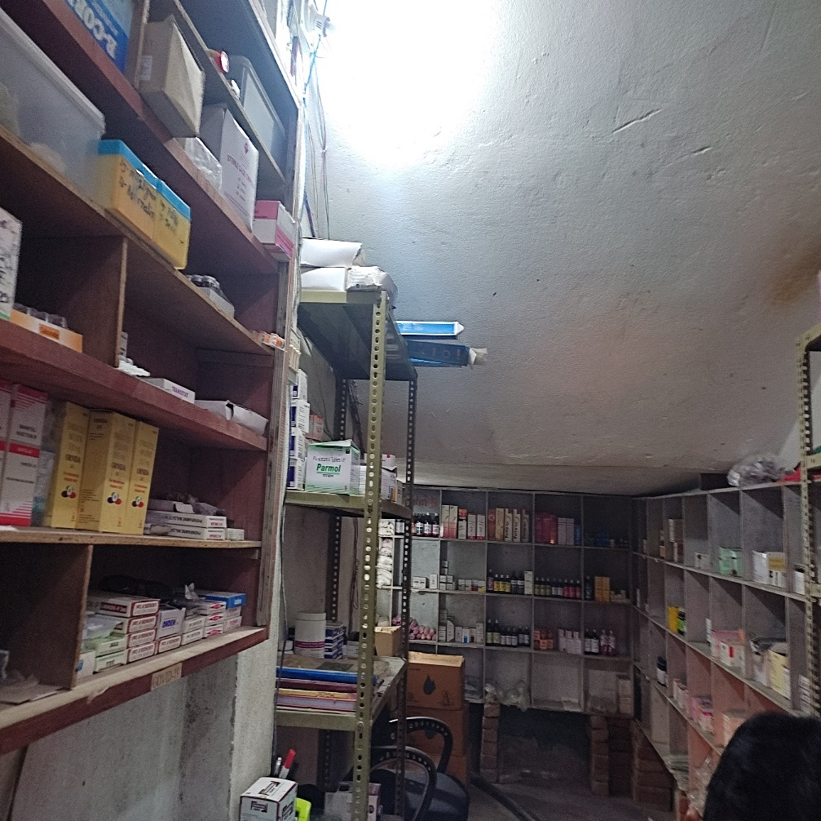
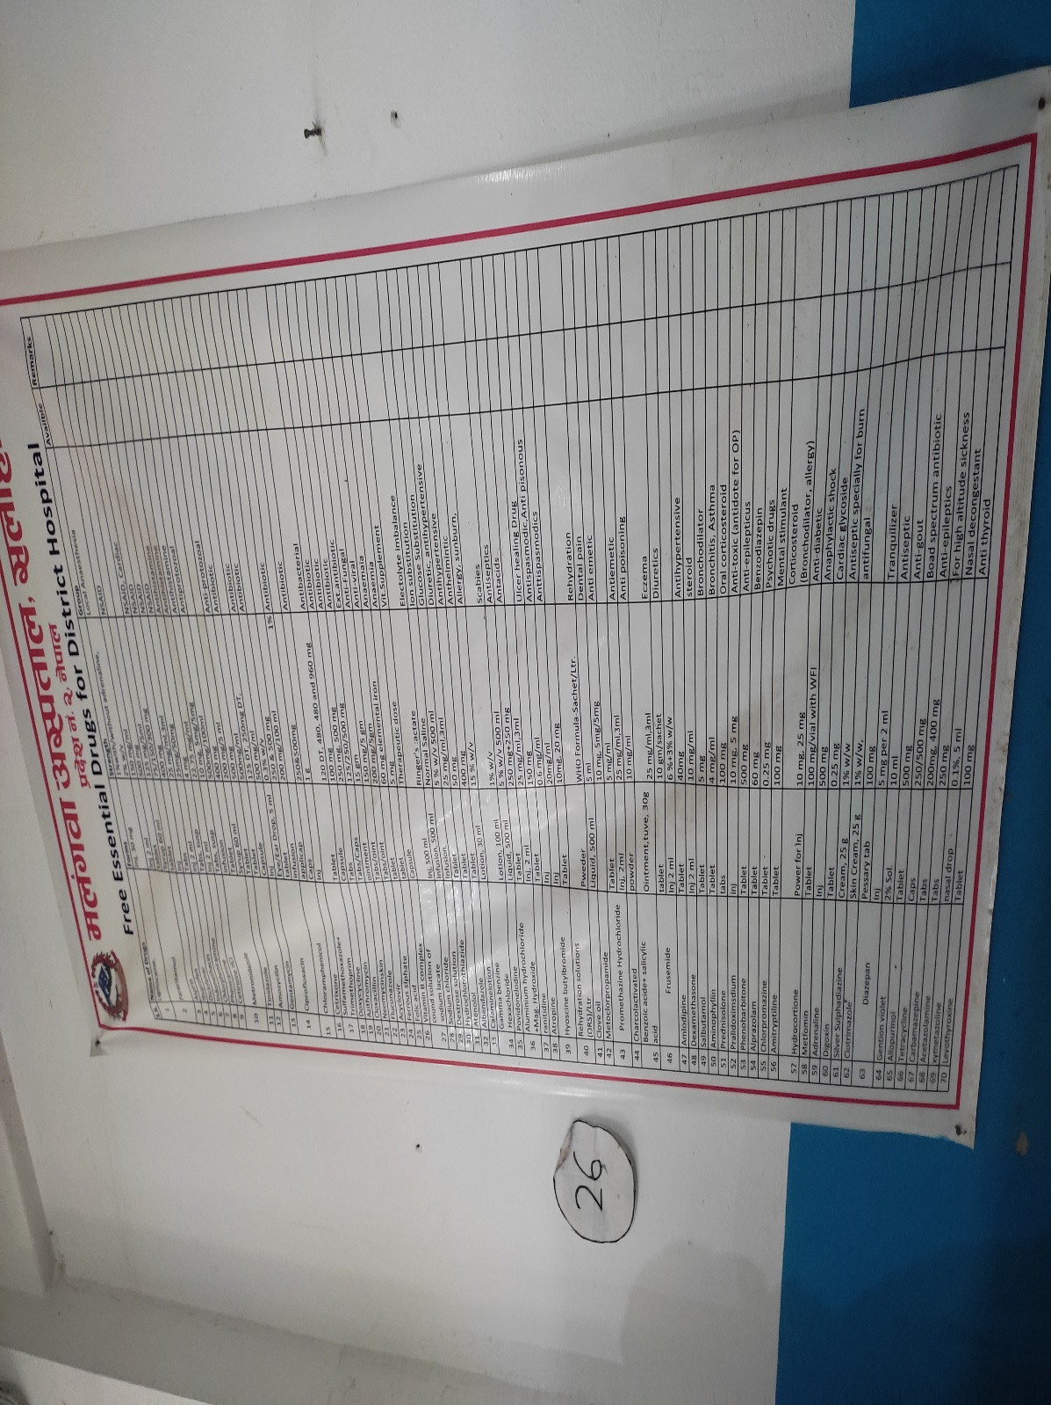
Pharmacy with free medicines list display

Slide 58
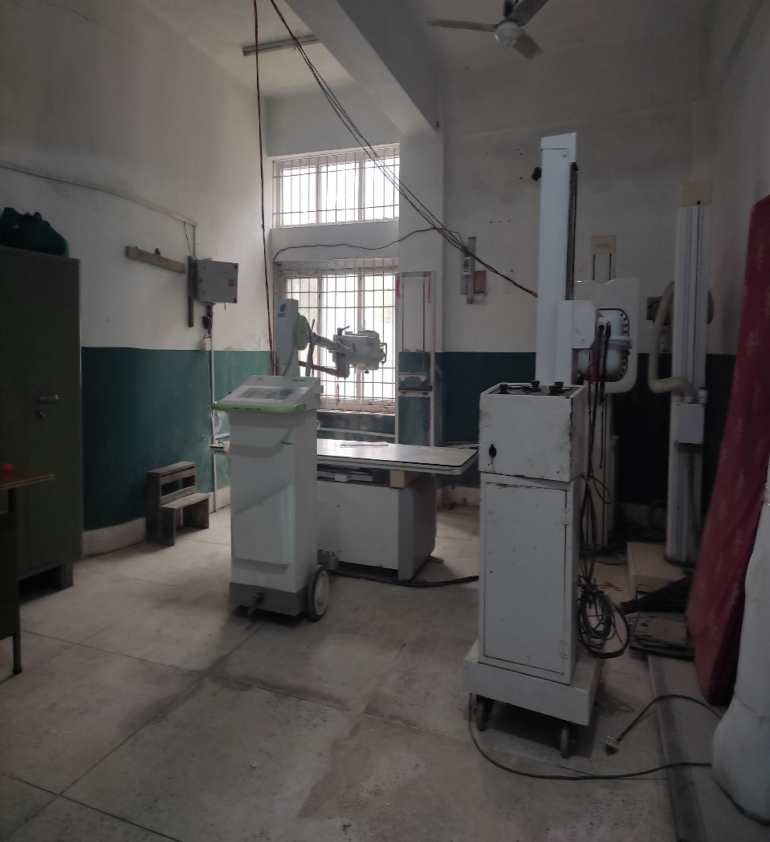
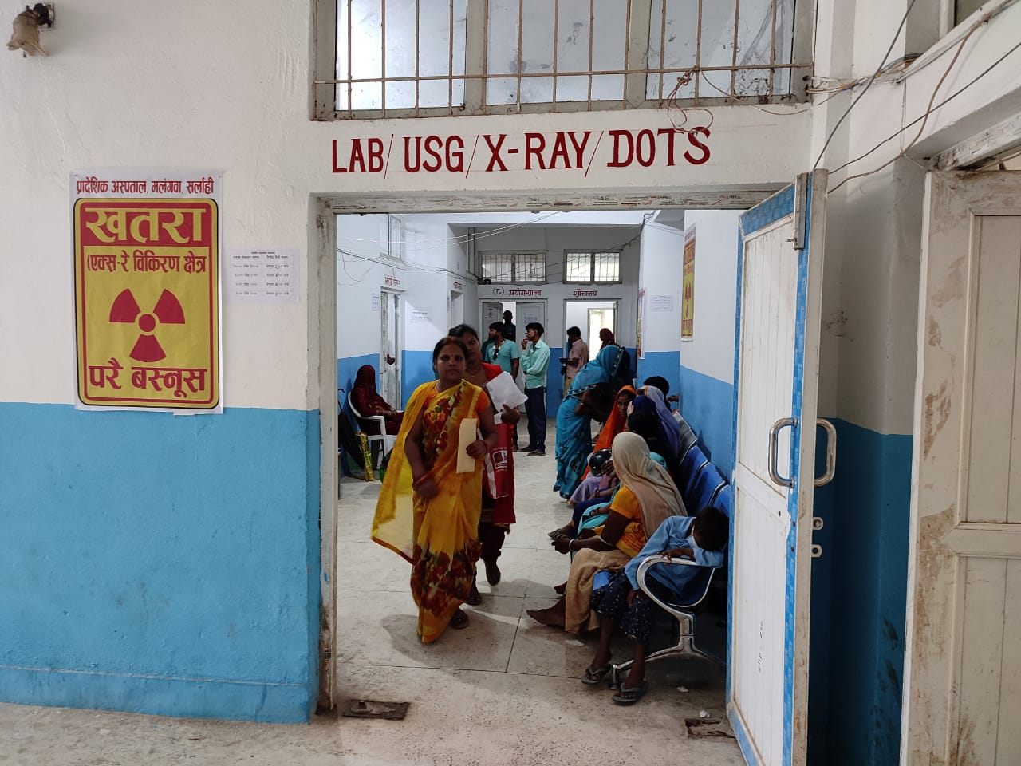
X-ray room And caution notice at door

Slide 59
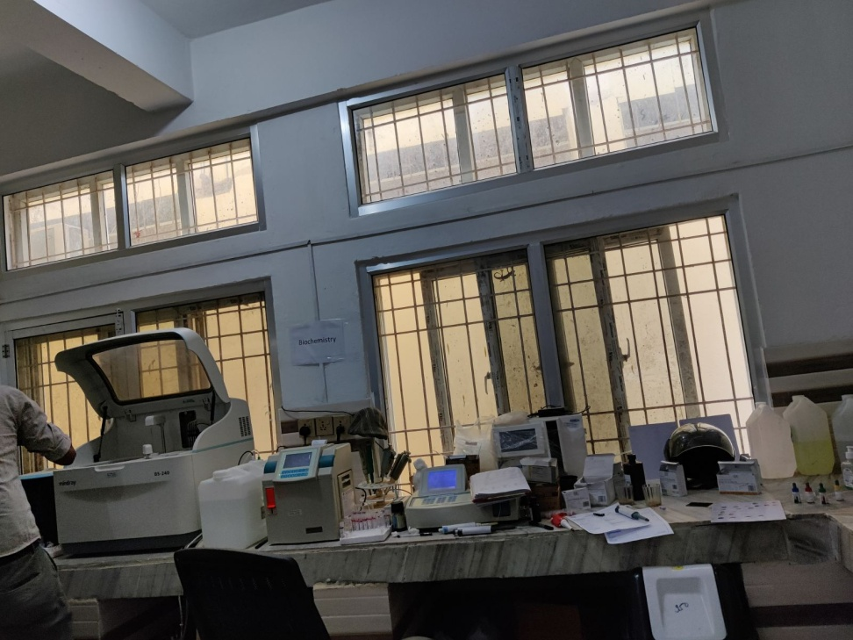
Lab Room

Slide 60
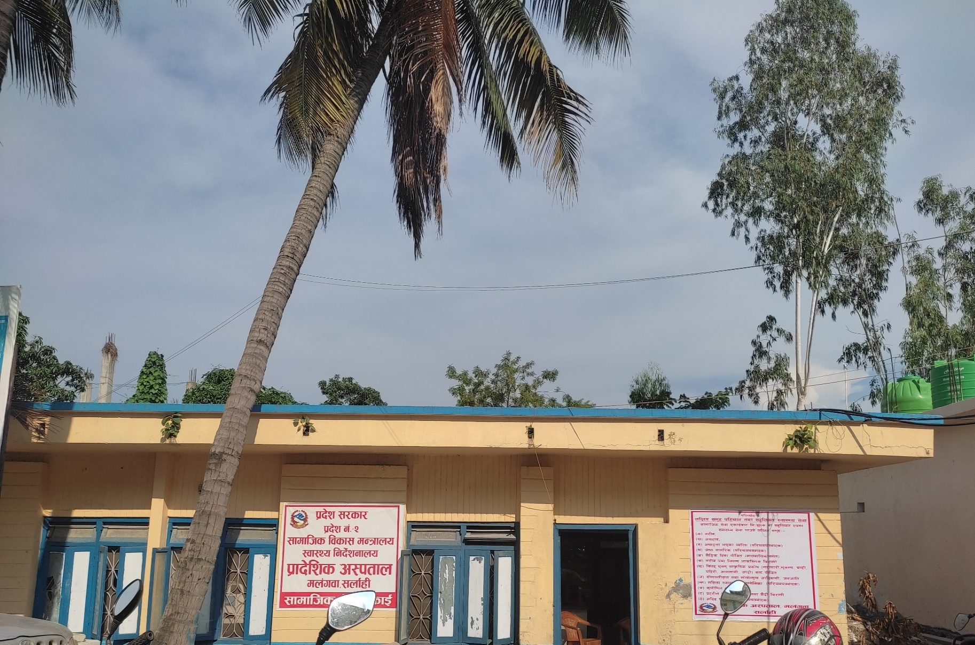
Social Service Unit

Slide 61
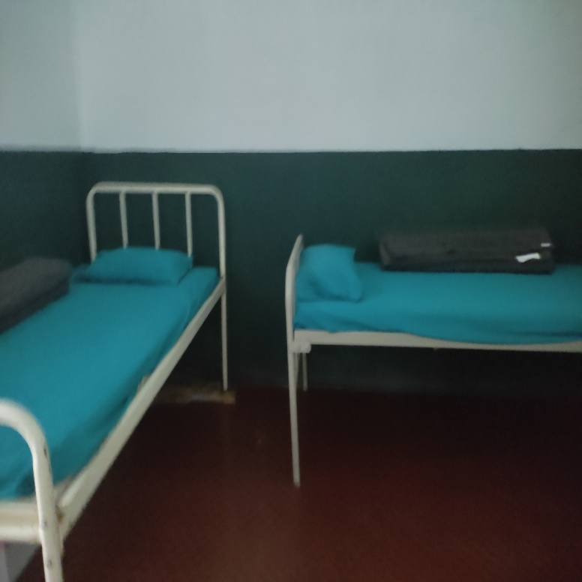
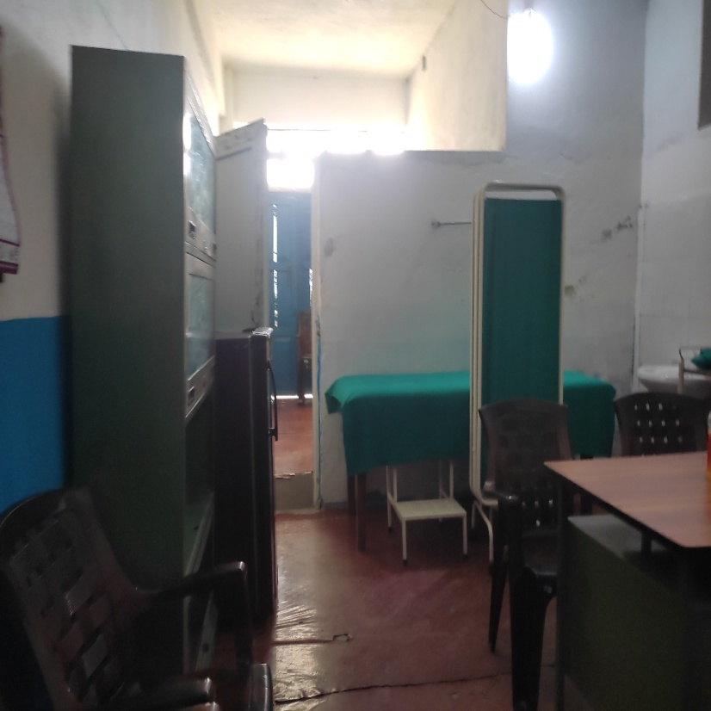
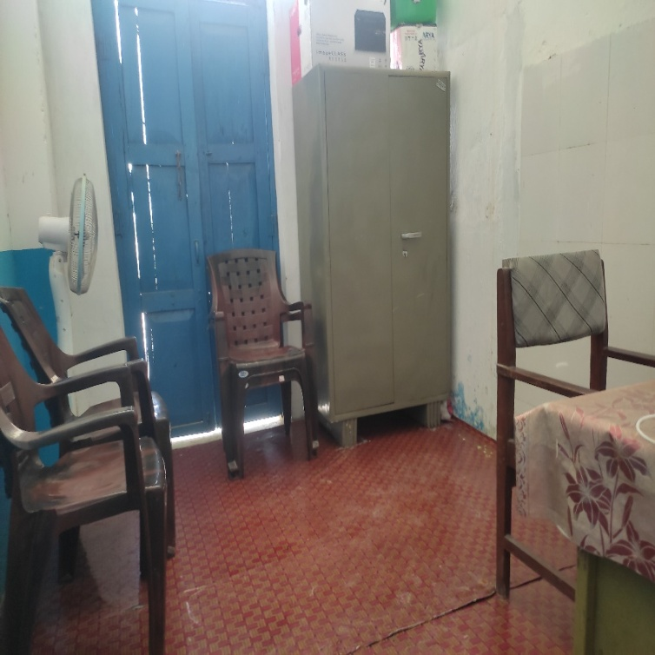
OCMC
ROOM

Slide 62
Thank You

